Slide 1
Lecture 1
Properties of liquid
Surface tension
Determination of surface tension
Parachor and structure elucidation

Slide 2
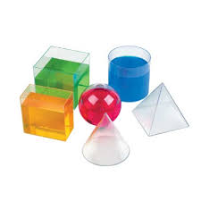
Properties of liquids
Liquids state is intermediate between solid and liquid.
Liquids do not have definite shape.
Molecules of liquids have intermediate order of cohesive forces.
Liquids resembles solids in terms of compressibility and density.
In liquids there is little space between molecules.

Slide 3
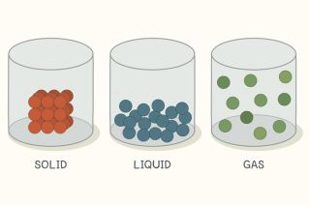
Figure 1: Relative spacing between molecules in solids , lquids and gases.

Slide 4
The compactness and cohesion observed in liquids are like solids and random motion of molecules is like that occur in gases.
Q: write down the properties of liquids?

Slide 5
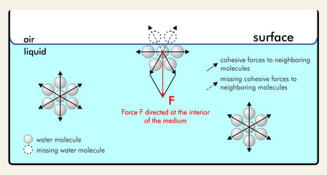
Surface tension
Surface tension is another property of the liquid related to intermolecular forces.

Slide 6
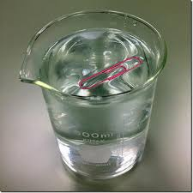
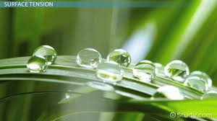
What do you see?

Slide 7
Surface tension is defined as “force in newton acting at right angles along the surface of a liquid one meter in length”.
It is represented by “ɣ” (gamma).
Units
Dynes cm⁻¹ or ergs cm ⁻²
Nm⁻¹ or Jm ⁻²
Do you know? 1 dyne cm⁻¹ = 10⁻³ Nm ⁻¹

Slide 8
Capillary Action
Which liquid wets the surface of the solid, depends upon the interaction between the liquid molecules and solid surface.
Contact angle (θ)
“the contact angle is angle between the tangent to the liquid surface at the point of contact and the solid surface inside the liquid”

Slide 9
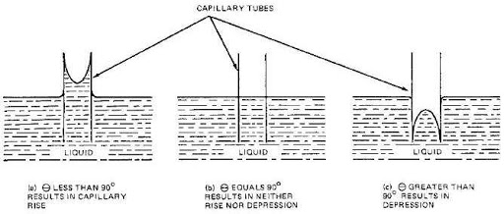
Its values ranges between 0ᵒ to 180ᵒ.
If value is less than 90ᵒ, the liquid wets the surface of the solid.
If value is greater than 90ᵒ,the liquid does not wet the surface.

Slide 10
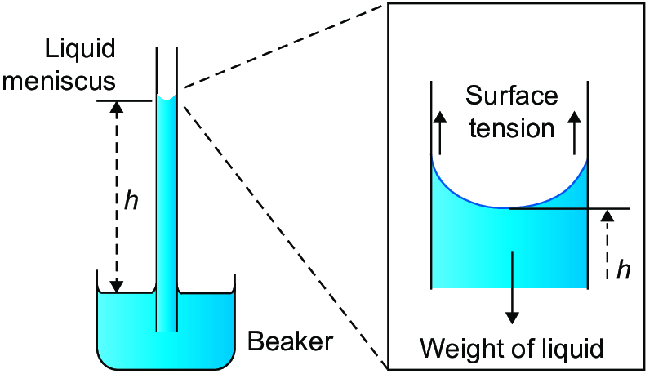
Measurement of Surface Tension
Capillary Rise method:
The rise or fall of liquid in the capillary tube depends upon the surface tension.

Slide 11
r =radius of capillary tube
h = height of liquid column
ɣ = Surface tension
Fu = Fd
The force due to surface tension is acting at the angle θ. The upward force is equal to the vertical component of the surface tension, i.e. ɣ Cosθ times circumference

Slide 12
Fu = 2πr. ɣ Cos θ --------- (1)
The downward force is given by:
Fd = weight of the liquid column
Fd = mg = Vdg---------- (2)
Volume of the liquid in the column is V= πr²h
At height “h”
Fu= Fd
So, 2πr. ɣ Cos θ = πr²hdg
Now simplify:
ɣ = rhdg/2Cosθ
If , θ = 0ᵒ
Then,
ɣ = rhdg/2

Slide 13
Numerical
The radius of a capillary tube is 1.05 x 10⁻⁴ m. Density of liquid is 0.80 g/cm³ rises to a height of 6.25 x 10⁻² m. calculate surface tension. (θ=0ᵒ).

Slide 14
The Drop Weight Method
In this method the liquid whose surface tension is to be measured is allowed to pass through a capillary tube held vertically.
The liquid that comes out of the capillary tube assumes a spherical shape and has some definite weight.
When the wt of drop becomes equal to surface tension, acting along the circumference of the tube, it falls down.

Slide 15
There fore,
ɣ 2πr = W = mg = Vdg----1
This method is generally used for comparison.
The instrument used to determine surface tension is called “stalagmometer”.

Slide 16
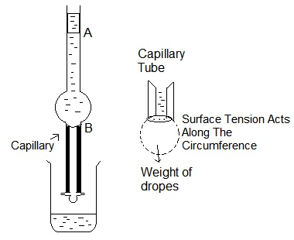
Stalagmometer is a bulbed capillary tube, it is filled upto mark A with the liquid.the liquid is then allowed to fall slowly, in the form of dropswhich are collected in the weighing bottle, the rate at which drops fall is adjusted in such a way, that every drop falls after 3 sec.
If W1 and W2 are the weights of 10 drops of two liquids , and ɣ1 and ɣ2 are their surface tension then,
ɣ1 / ɣ2 = W1 / W2 -------(1)

Slide 17
It is more convenient to determine the number of drops of fixed volume of liquid than to determine weight.
If n₁ and n₂ are the number of drops of two liquids and d1 and d2 are their densities. Then average weight of liquid drops is
W₁ = m₁g/n₁= Vd₁g/n₁
W₂= Vd₂g/n₂
putting the values of W₁ and W₂ in the following equation:
ɣ₁ / ɣ₂ = W₁ / W₂ -------(1)
We get
ɣ₁ / ɣ₂ = d₁ n₂ /n₁d₂

Slide 18
Numerical
At 293 K, 10⁻² dm³ of water formed 29 drops, and the same volume of other liquid formed 86 drops in the same stalagmometer. Density of organic liquid is 0.7 g/cm³ and water is 1 g/cm³. The surface tension of water is 7.2 x 10⁻² Nm⁻¹.determine the surface tension of organic liquid?

Slide 19
Surface Tension and Chemical Constitution-Parachor
The empirical relationship between surface tension and density for normal liquids is given by D.B Macleod in 1923:
Ɣ ^{1/4} / D-d = C
Where,
D = Density of liquid
d = Density of vapours
C= Constant, is independent of temperature for non-associated liquids and increases for associated liquid, with rise in temperature.

Slide 20
Sudgen (1924) multiplied the Macleod equation with molecular mass and obtained a new constant called Parachor.
MƔ ^{1/4} / D-d = MC = [P]
At temperature below critical temperature D>>d, So
MƔ ^{1/4} / D = [P]
M/D is molar volume (Vm)of liquid,if surface tension = 1, then
[P]= Vm
So, Parachor is defined as the molar volume of the liquid at a temperature where its surface tension is unity.
Parachor is both additive and constitutive property, it value is expressed as two sets of constants.

Slide 21
Numerical
The surface tension of benzene is 29.2 dynes / cm, its density is 0.88 g/cm³.Calculate its parachor value?

Slide 22
Application of Parachor value to elucidate the structure
Structure of benzene
To calculate the parachor value of benzene
6C = 4X 4.8= 28.8
6H= 6X 17.1= 102.6
3 Double bonds = 3x 23.3 = 69.6
1 ring =1x 6.1 = 6.1
Total : 207.1
Observed parachor value = 206.4
So,………..

Slide 23
Structure of Quinone
[P]= 236.1
[P]= 219.0
Observed value = 236.8

Slide 24
Position of substituent doesnot change the parachor value.
The observed value of o-chlorotoluene is 280.8 and for p-chlorotoluene is 283.6 and theoretical value for both isomers is same that is 283.3.

Slide 25
Applications of Surface tension
Cleansing action of soap
Tooth paste
Nasal jellies
Mouth washes
Look for more………..

